Slide 1

Dye Screening Using Machine Learning
${Sven Marnauzs}^{1}$, ${Lawrence Spear}^{2}$, Lan Li²
Department of Mathematics, Boise State University¹
Materials Science and Engineering, Boise State University²

Slide 2
Machine Learning Introduction
Brief introduction to machine learning
Lawrence

Slide 3
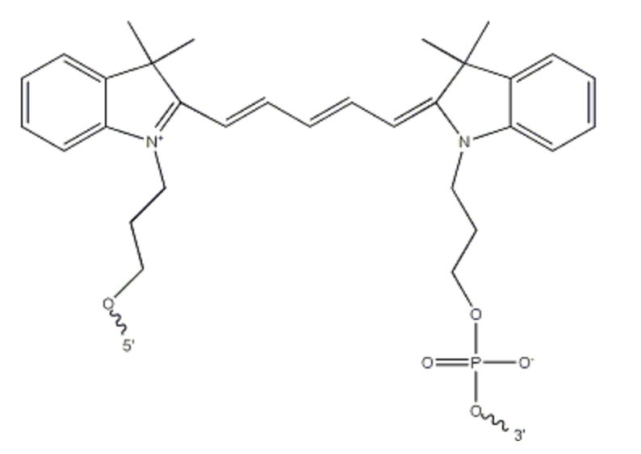
Overview of Dye Screening Project
Created dataset of 364 compounds
Where data comes from
Data includes
Extinction coefficient
Composition: Number of C, H, N, O atoms within compound
Length of the carbon conjugate
see Figure (1)
Figure 1: Structure of Cy5. We recorded the length of this dye’s carbon conjugate to be 6.

Slide 4
Classifying Compounds
We separated compounds into two classes
Extinction coefficient over 150,000 (1/M)(1/cm)
Extinction coefficient under 150,000 (1/M)(1/cm)
Positive samples
Negative samples

Slide 5
Training a Classifier
We then trained a logistic regression classifier using the
Composition
The length of the carbon conjugate
as input features and the compound class as the target feature to guide the classifier.

Slide 6
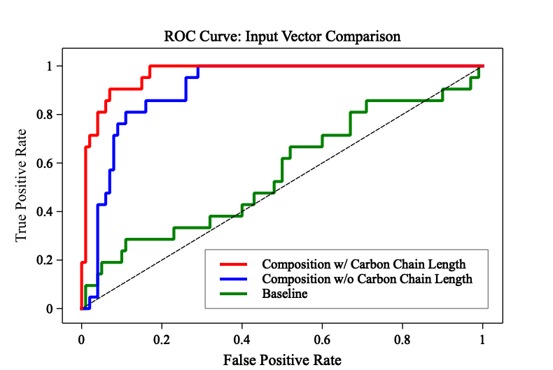
Results: Input Vector Comparison
Used logistic regression and explain
Training Algorithm | Carbon Chains? | Accuracy | Precision | Recall | F1 Score | AUC Score
Logistic Regression | Yes | 0.92 | 0.72 | 0.85 | 0.78 | 0.97
Logistic Regression | No | 0.87 | 0.63 | 0.57 | 0.6 | 0.9
Baseline Negative | N/A | 0.83 | Undefined | 0 | Undefined | 0.5

Slide 7
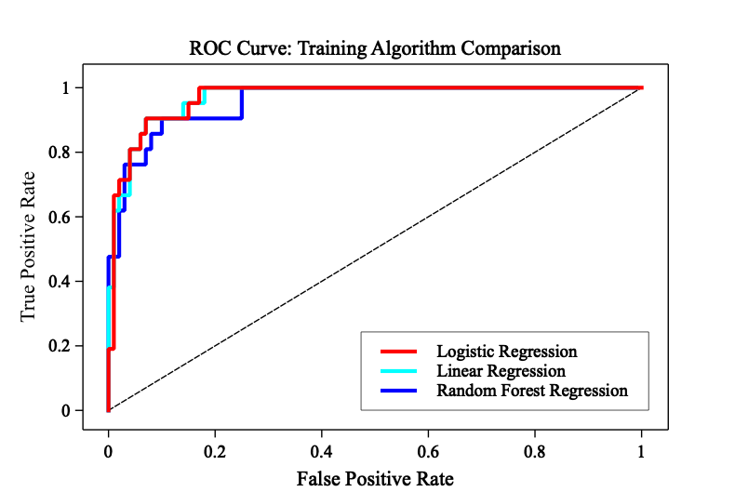
Results: Model Comparison
Figure 3
Table 2
Training Algorithm | Carbon Chains? | Accuracy | Precision | Recall | F1 Score | AUC Score
Logistic Regression | Yes | 0.92 | 0.72 | 0.85 | 0.78 | 0.97
Linear Regression | Yes | 0.91 | 0.7 | 0.9 | 0.79 | 0.96
RF Regression | Yes | 0.9 | 0.7 | 0.8 | 0.75 | 0.96

Slide 8
Guiding Experiment
How machine learning can provide guidance to experimentalists
Lawrence and Sven
 | LinReg_coef_1 | LinReg_coef_2 | LogisticReg_1 | LogisticReg_2
C | 2168 | 1616 | 0.8 | 0.5
H | 1951 | 621 | 0.75 | 0.31
N | 447 | 4795 | 0 | 0.54
O | 120 | -971 | 0.12 | -0.149
C_Chain |  | 20361 |  | 1.67

Slide 9
Q & A
Feedback?
Lawrence and Sven

